Slide 1
Matrix Multiplication
https://www.youtube.com/watch?v=QHWJONiTbmQ

Slide 2
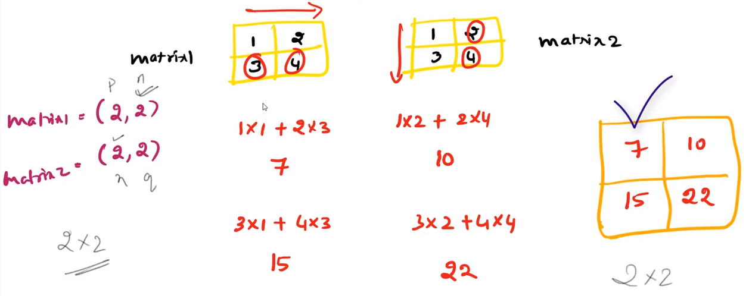

Slide 3
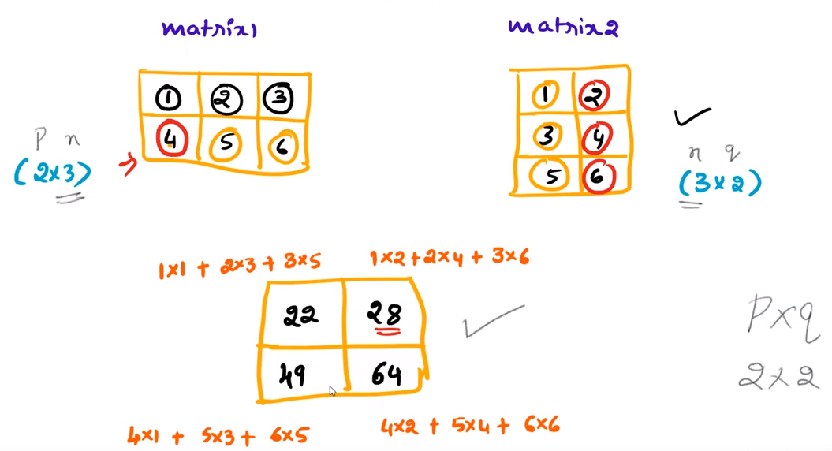

Slide 4
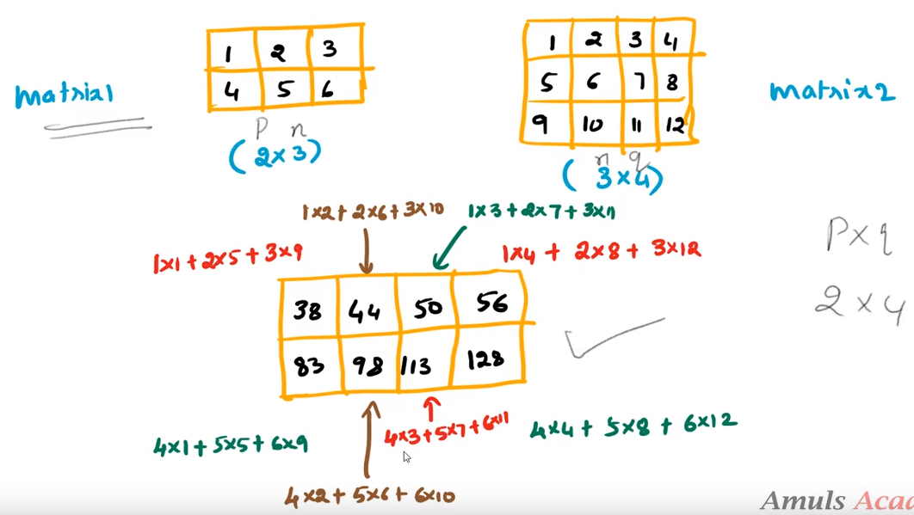

Slide 5
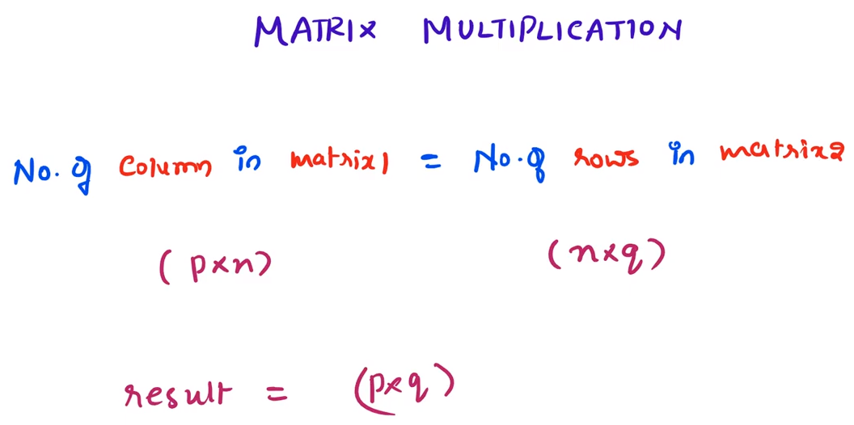

Slide 6
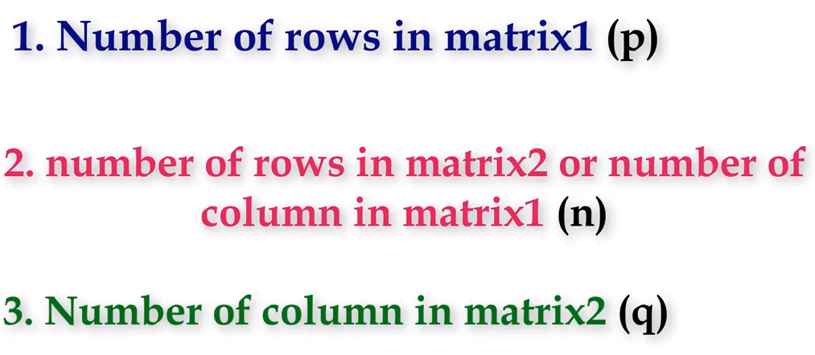

Slide 7
Refer YouTube for code

